Slide 1
Analyzing Flood Risk Zones Harris County, Texas
By: Nikhil Chhatraband
Apps in Geospatial Analytics (CE502D1_F24)
Professor Mehmet Ozdes

Slide 2
Background
Harris County is a large area in the U.S. with over 4 million people. It’s near the Gulf of Mexico, which makes it flood often.
In 2017, Hurricane Harvey caused heavy rain and serious flooding. It damaged the area badly and cost $125 billion.
The flooding got worse because more people moved there, and more buildings and roads were built. These hard surfaces don’t soak up water.
Almost 40% of the area is covered with these hard surfaces, which makes flooding even worse.

Slide 3
Problem Statement
The project’s goal is to find out what makes flooding worse in Harris County, Texas
It will study how hard surfaces (like roads) and low land areas (elevation) are connected to flood zones.
The project will also look at existing flood maps to understand the known risks and see how these factors add to the problem.
The study expects to find that areas with more hard surfaces, lower land, and locations near water are at higher risk of flooding.
Previous studies by the USGS showed that hard surfaces make flooding worse because water can’t soak into the ground.
To analyze this, tools like FEMA flood maps, Harris County data, and GIS software (ArcMap and ArcGIS) will be used.

Slide 4
Methodology
Data Sources:
1 Harris County Boundary Shapefile:
Source: HCAD GIS data set
Projection: NAD 1983 State Plane Texas South Central FIPS 4204 Feet
2 Harris County Impervious Cover data:
Source: City of Houston; SIMMER project
Projection: NAD 1983 State Plane Texas South Central FIPS 4204 Feet
3 National Elevation Dataset (NED):
Source: Texas National Elevation Dataset
Projection: NAD 1983 UTM Zone 15N
4 Harris County Floodplain Data:
Source: FEMA 2015 Floodplain
Projection: NAD 1983 State Plane Texas South Central FIPS 4204 Feet
Tools: ArcGIS Pro
Steps: Data collection, preprocessing, reclassification, and spatial analysis

Slide 5
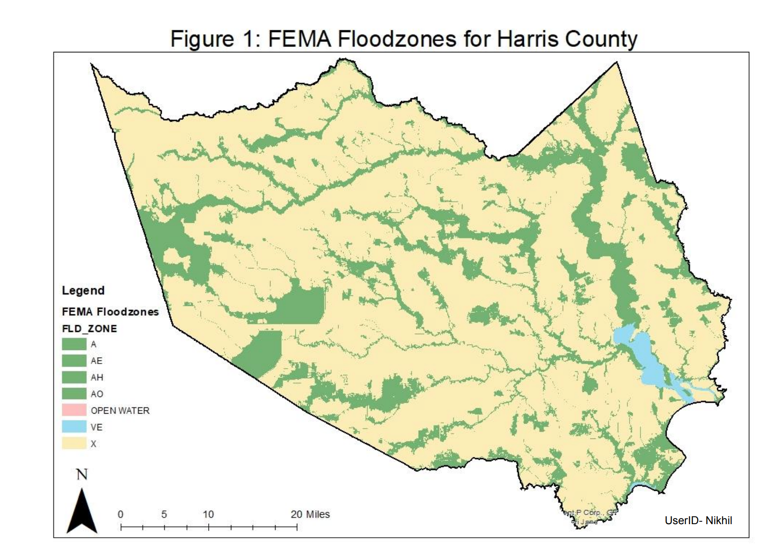
FEMA Flood Zones for Harris County
This map shows the FEMA-designated flood zones in Harris County,
categorized by flood risk:
Zone X (yellow): Areas outside the 100-year floodplain, representing lower flood risk.
Zones A, AE, AH, AO (various greens): High-risk flood zones, falling within the 100-year floodplain.
Zone VE (blue): Coastal areas prone to flooding due to storm surges and high tides.
Open Water (red): Permanent water bodies like lakes and reservoirs.
Key Insight:
High-risk flood zones are concentrated near rivers, streams, and low-lying areas.
Understanding these zones helps identify areas that need better flood management and planning.

Slide 6
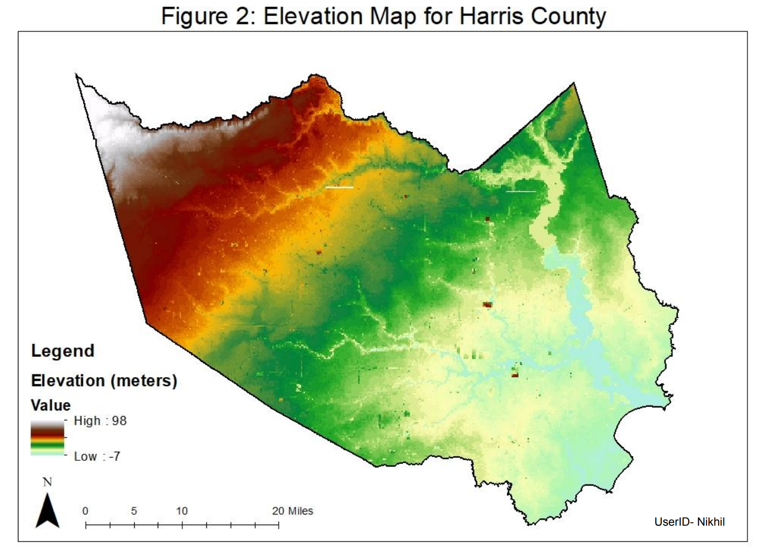
Elevation Map for Harris County
This map illustrates the elevation levels across Harris County, ranging from -7 meters to 98 meters above sea level.
The color gradient:
Green shades indicate low-lying areas (prone to flooding).
Red/orange shades represent higher elevations (safer from flooding).
Key Insights:
Low-lying areas in green are concentrated in the eastern and southern parts of the county.
These areas align with flood-prone zones seen in the FEMA map, confirming that elevation is a critical factor in flood risk.
High elevation areas in red are located towards the northwest, which are generally safer from flooding.

Slide 7
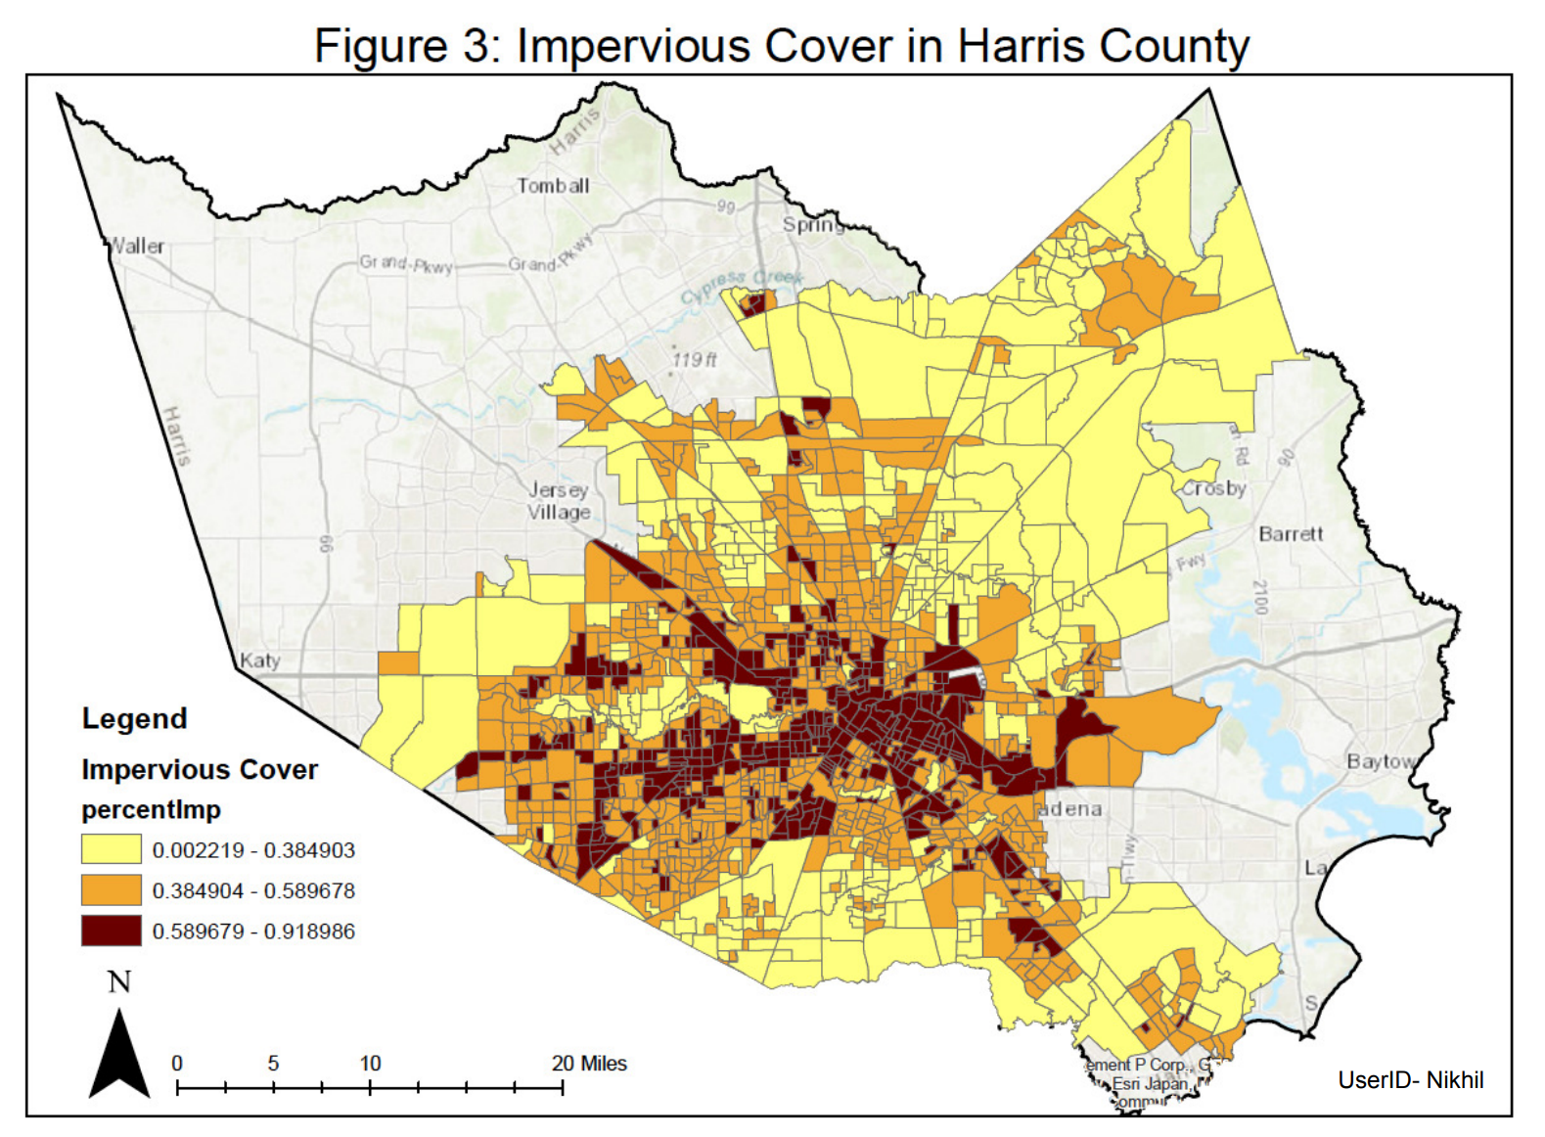
Impervious Cover in Harris County
This map shows the percentage of impervious cover (hard surfaces like roads, buildings, and parking lots) across Harris County.
Color Gradient Explanation:
Yellow: Low impervious cover (0–38%).
Orange: Medium impervious cover (38–59%).
Dark Brown: High impervious cover (59–92%).
Key Insights:
The dark brown areas, mostly in central Harris County, represent urban regions like downtown Houston with the highest impervious cover.
Yellow areas dominate the outskirts and suburbs, indicating less urbanized regions with lower impervious surfaces.
High impervious cover correlates with reduced water infiltration and increased flood risks, particularly in heavily urbanized zones.

Slide 8
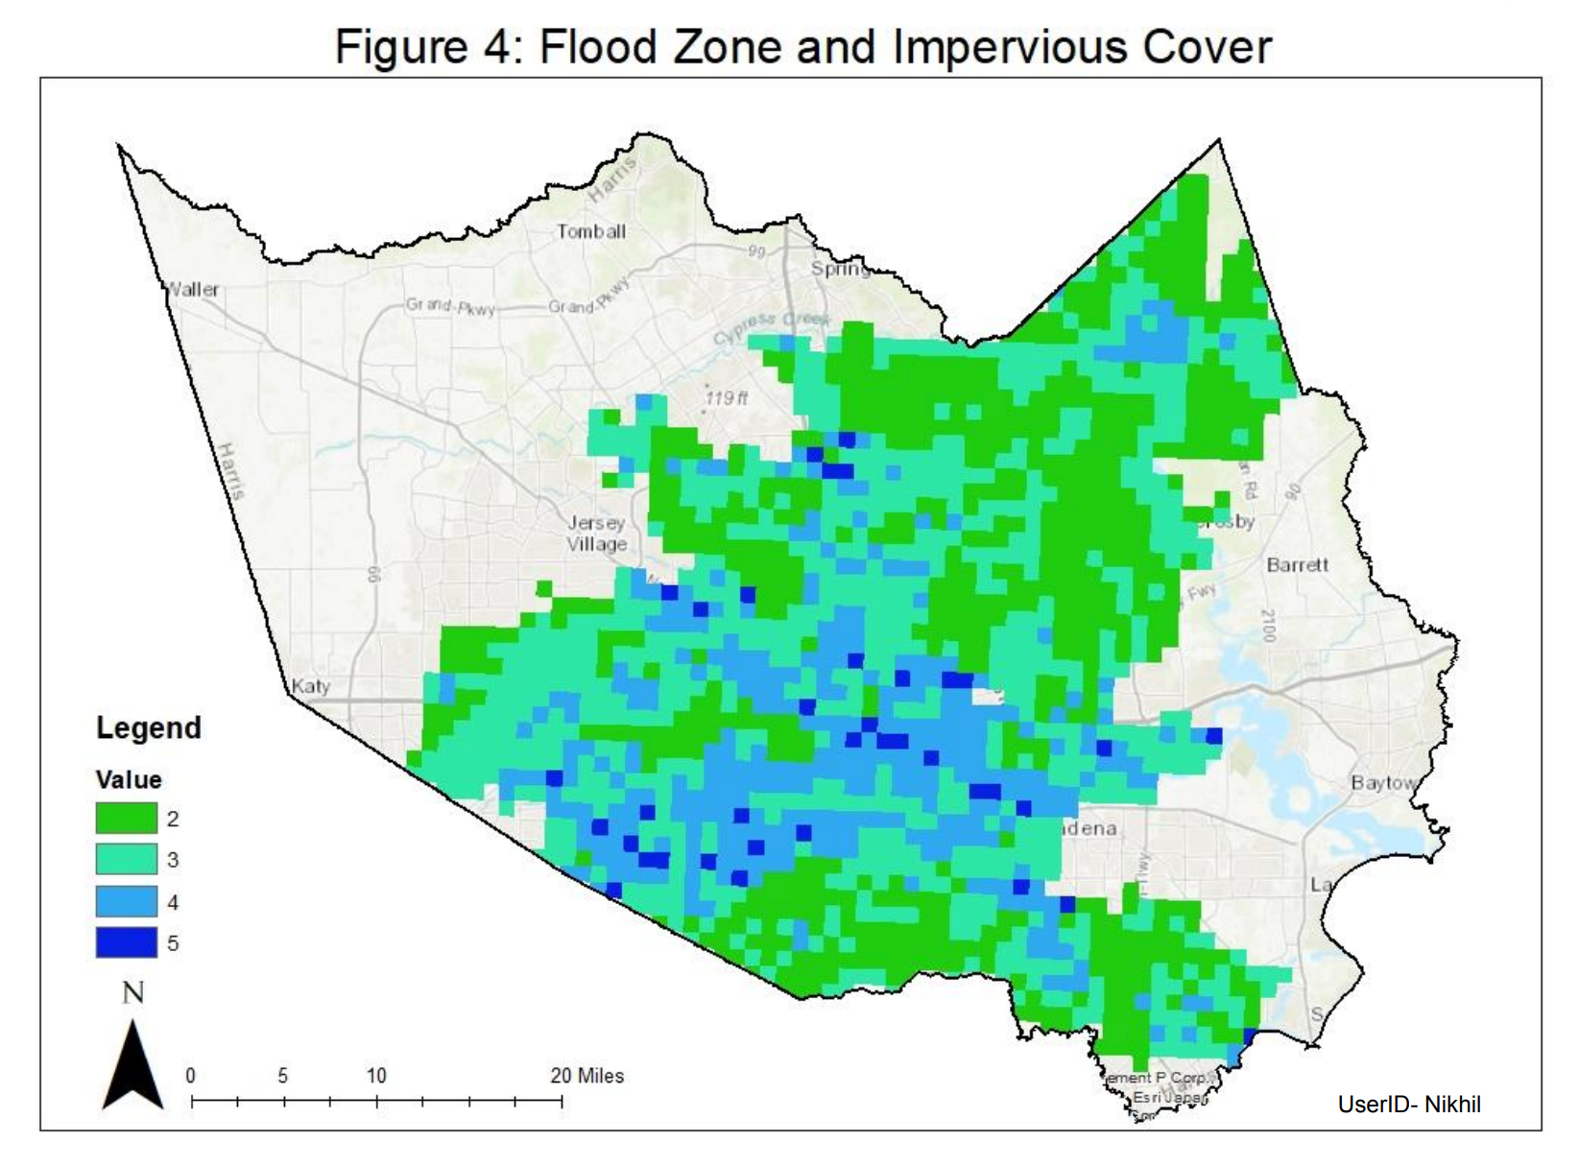
Flood Zone and Impervious Cover Analysis
This map combines flood zones and impervious cover rankings to analyze overall flood risk in Harris County.
Color Gradient Explanation:
Green (2-3): Lower flood risk, typically in areas with less impervious cover or higher elevation.
Blue (4-5): Higher flood risk, often in areas with high impervious cover and low elevation.
Key Insights:
High-risk areas (dark blue) are concentrated in urbanized regions with dense impervious surfaces and low-lying elevations.
Lower-risk areas (green) are primarily in the less developed, suburban, or rural parts of the county.
The combination of datasets highlights areas where urban planning and flood mitigation efforts should be prioritized.

Slide 9
Results and Conclusion
Results:
Low impervious cover (Rank 3) and flood zone X (low risk) dominate the suburbs (light green in Figure 4).
High impervious cover and flood risks are concentrated in downtown areas (dark blue in Figure 4).
Figures 3 and 4 confirm that higher impervious cover correlates with higher flood risks.
Conclusion:
Increased urbanization raises flood risks due to more impervious surfaces and lower infiltration.
Lower elevations in flood zones (Figure 2) align with waterways and higher flood risks (Figure 1).

Slide 10
Recommendations:
Houston is mitigating flood risks by:
Improving drainage systems (e.g., channel modifications).
Using stormwater retention basins and levees.
Future planning should focus on sustainable urbanization to reduce impervious surfaces.

Slide 11
Acknowledgments
We are grateful to Professor Mehmet Ozdes for your guidance throughout this semester
To Shubham and Siddhesh, thanks for all the tips and suggestions

Slide 12
References
https://msc.fema.gov/portal/availabilitySearch?addcommunity=480296&communityName=HOUSTON,%20CITY%20OF#searchresultsanchor
https://geo-harriscounty.opendata.arcgis.com/
https://www.fema.gov/press-release/20230425/harris-county-texas-flood-maps-become-final
https://search.earthdata.nasa.gov/search/granules?p=C2675647245-SEDAC&pg[0][v]=f&pg[0][gsk]=-start_date&tl=1732992504!3!!&lat=76.47628783848899&long=-257.0236880103902&zoom=1

Slide 13
Thank you!

